Slide 1
Scaling diagrams for multiplicative relationships
Understanding multiplicative relationships: percentages and proportionality

Slide 2
how to use Oak lessons

Slide 3
I can use a scaling diagram to represent a multiplicative relationship and connect to other known representations.

Slide 4
Proportion is a part to whole (sometimes part to part) comparison. If two things are proportional then the ratio of part to whole is maintained and the multiplicative relationship between parts is also maintained.

Slide 5

Scaling diagrams for multiplicative relationships
Scaling diagrams
Comparing representations

Slide 6
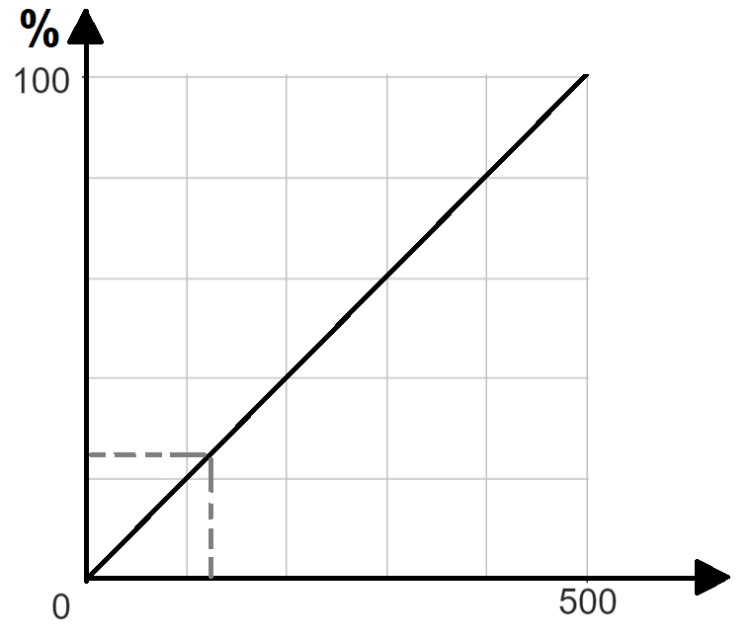
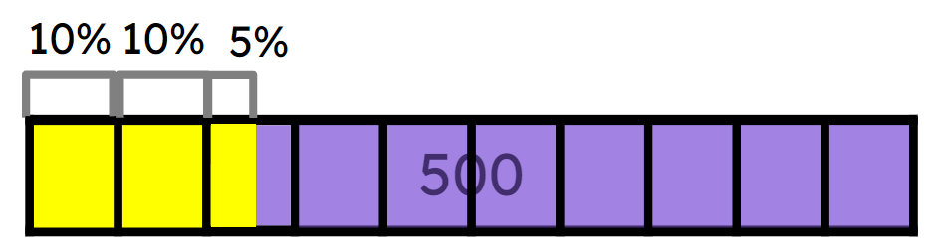
Scaling diagrams
Proportion can be represented in lots of different ways.
Look at these diagrams. What do you think the question is to all of these answers?
Amount | %
500 | 100
50 | 10
25 | 5
100 | 20
25
100
%
A
125
500
Amount

Slide 7
Scaling diagrams
They all are showing the answer to 25% of 500.
Amount | %
500 | 100
50 | 10
25 | 5
100 | 20
25
100
%
A
125
500
Amount

Slide 8
Scaling diagrams
Looking at the double number line and graph, these show how a pair of numbers align when scaled proportionally.
We can explore where this comes from by looking at a scaling diagram.
This emphasises multiplication as scaling.
25
100
%
A
125
500
Amount

Slide 9
Scaling diagrams
For example, let’s look at this double number line.
What is it showing?
100% is £200
A double number line is a condensed version of a scaling diagram.
100
%
£
200

Slide 10
Scaling diagrams
For example, let’s look at this double number line.
What is it showing?
100% is £200
So let’s separate the double number line.
100
%
£
200

Slide 11
Scaling diagrams
For example, let’s look at this double number line.
What is it showing?
100% is £200
Now, we can ‘un-squash’ or stretch the bottom number line.
100
%
£
200

Slide 12
Scaling diagrams
For example, let’s look at this double number line.
What is it showing?
100% is £200
Now, we can ‘un-squash’ or stretch the bottom number line.
100
%
£
200
£
200

Slide 13
Scaling diagrams
For example, let’s look at this double number line.
What is it showing?
100% is £200
Now, we can ‘un-squash’ or stretch the bottom number line.
100
%
£
200
£
200

Slide 14
Scaling diagrams
For example, let’s look at this double number line.
What is it showing?
100% is £200
A completed scaling diagram now shows mappings of numbers.
0
100
%
£
200
£
0
200

Slide 15
Scaling diagrams
For example, let’s look at this double number line.
What is it showing?
100% is £200
A completed scaling diagram now shows mappings of numbers.
0
100
%
100% is £200
£
200
£
0
200

Slide 16
Scaling diagrams
To ensure we map the other numbers correctly, we can find the intervals.
What do you think are the intervals for each scaled line?
100% ÷ 10 = 10% for each interval
£200 ÷ 10 = £20 for each interval
0
100
10
20
30
40
50
60
70
80
90
%
£
200
£
0
20
40
60
80
100
120
140
160
180
200

Slide 17
Scaling diagrams
Now it is clear to see which percentage maps to which amount of money.
100% = £200
90% = £180
80% = £160
70% = £140
60% = £120
40% = £80
0
100
10
20
30
40
50
60
70
80
90
30% = £60
%
20% = £40
£
10% = £20
200
£
0
20
40
60
80
100
120
140
160
180
200

Slide 18
Scaling diagrams
Here is a scaling diagram. Fill in the missing intervals and write down 60% of £350
100% ÷ 5 = 20% for each interval
£350 ÷ 10 = £35 for each interval
60% of £350 = £210
0
20
40
60
80
100
%
35
70
105
140
175
210
245
280
315
£
0
350

Slide 19
Scaling diagrams
Fill in the missing information (including arrows) using the scaling diagrams.
a)
0
20
40
60
80
100
Show 60% of 150 = 90
%
£
0
15
30
45
60
75
90
105
120
135
150
0
20
40
60
80
100
Show 40% of 240 = 96
b)
%
£
0
24
48
72
96
120
144
168
192
216
240

Slide 20
Scaling diagrams
2) Fill in the missing information (including arrows) using the scaling diagrams.
a)
0
Show 60% of 120 = 72
20
40
60
80
100
%
£
0
24
48
72
96
120
b)
0
25
50
75
100
%
Show 75% of 140 = 105
£
0
14
28
42
56
70
84
98
112
126
140

Slide 21
Scaling diagrams
3) Fill in the missing information (including arrows) using the scaling diagrams.
a)
0
20
40
60
80
100
Show 60% of 80 =
%
£
0
16
32
48
64
80
Show 40% of 70 =
0
10
20
30
40
50
60
70
80
90
100
b)
%
£
0
20
40
60
80
70

Slide 22
Scaling diagrams
Fill in the missing information (including arrows) using the scaling diagrams.
a)
0
20
40
60
80
100
Show 60% of 150 = 90
%
£
0
15
30
45
60
75
90
105
120
135
150
Show 40% of 240 = 96
b)
0
20
40
60
80
100
%
20 ÷ 5 = 4 intervals for each 20%
£
0
24
48
72
96
120
144
168
192
216
240

Slide 23
Scaling diagrams
2) Fill in the missing information (including arrows) using the scaling diagrams.
Show 60% of 120 = 72
a)
0
20
40
60
80
100
%
£
0
24
48
72
96
120
b)
0
25
50
75
100
%
Show 75% of 140 = 105
£
0
14
28
42
56
70
84
98
112
126
140

Slide 24
Scaling diagrams
3) Fill in the missing information (including arrows) using the scaling diagrams.
a)
0
20
40
60
80
100
Show 60% of 80 = 48
%
£
0
16
32
48
64
80
Show 40% of 70 = 28
0
10
20
30
40
50
60
70
80
90
100
b)
%
£
0
14
28
42
56
70

Slide 25
Scaling diagrams for multiplicative relationships
Scaling diagrams
Comparing representations

Slide 26
Comparing representations
We can also find percentages of amounts using scaling diagrams.
0
10
20
30
40
50
60
70
80
90
100
%
£
200
£
0
20
40
60
80
100
120
140
160
180
200

Slide 27
Comparing representations
Let’s start by putting the information from our scaling diagram into a ratio table.
Amount | %
200 | 100
As the amount and percentage are proportional, we have a constant multiplier. Can you see it?
 | 90
180
 | 40
80
 | 10
20
0
100
10
20
30
40
50
60
70
80
90
%
200
£
0
20
40
60
80
100
120
140
160
180
200

Slide 28
Comparing representations
We can work out a constant multiplier to be ×2 from the percentage to give the amount.
Amount | %
200 | 100
×2
 | 90
180
×2
 | 40
80
×2
 | 10
0
20
×2
10
20
30
40
50
60
70
80
90
100
%
×2
200
£
0
20
40
60
80
100
120
140
160
180
200

Slide 29
Comparing representations
Scaling diagrams show the multiplicative relationship as a stretch or a squash. How about trying to find more complicated percentages, such as 23%?
Amount | %
200 | 100
×2
180
 | 90
180
×2
80
 | 40
80
×2
20
 | 10
0
20
×2
10
20
30
40
50
60
70
80
90
100
%
200
£
?
0
20
40
60
80
100
120
140
160
180
200
Accuracy of this is dependent on the accuracy of the scale.

Slide 30
Comparing representations
Using a ratio table can allow for any amount or percentage to be calculated.
23% of 200 =
Amount | %
200 | 100
×2
46
 | 90
180
×2
 | 40
80
×2
 | 10
0
20
×2
10
20
30
40
50
60
70
80
90
100
%
 | 23
46
×2
200
£
?
0
20
40
60
80
100
120
140
160
180
200

Slide 31
Comparing representations
Using the scaling diagrams, fill in the ratio table.
Amount | %
80 | 100
 | 40
 | 16
0
20
40
60
80
100
× 0.8
×……
%
32
£
× 0.8
12.8
× 0.8
0
16
32
48
64
80
0
20
40
60
80
100
Amount | %
150 | 100
 | 80
 | 34
%
×1.5
×……
×1.5
120
30
60
90
120
£
51
0
150
×1.5

Slide 32
Comparing representations
Fill in the missing information on the ratio table and the scaling diagram.
0
20
40
60
80
100
Amount | %
 | 100
 | 40
 | 15
%
×…..
×……
£
0
80
160
0
100
Amount | %
 | 100
 | 60
 | 24
%
×….
×…..
£
0
105
210

Slide 33
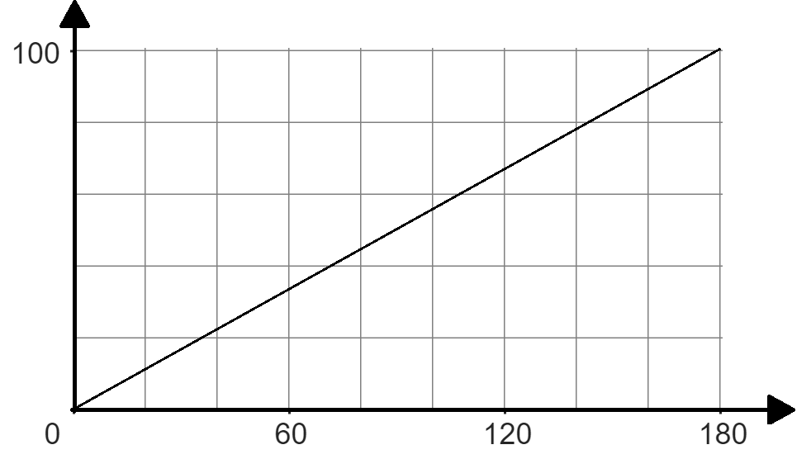
Comparing representations
2a) Fill in the missing information, using the different representations.
0
20
40
60
80
100
Amount | %
 | 100
 | 40
 | 15
%
×……
£
0
36
72
108
144
180
%
40
100
%
£
72
180
£

Slide 34
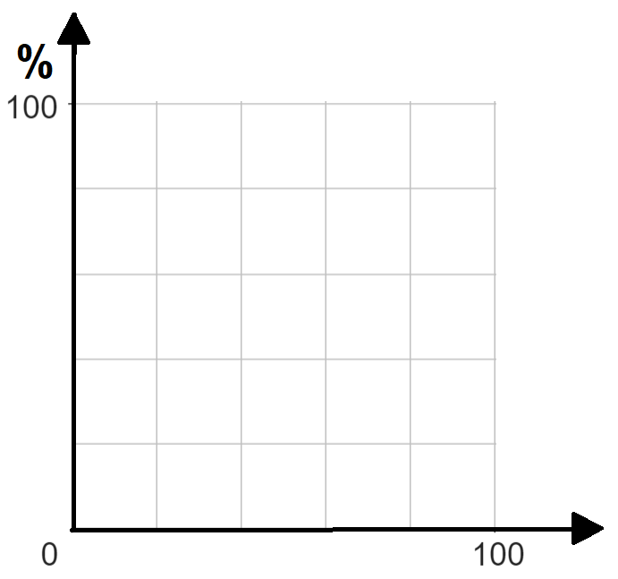
Comparing representations
2b) Fill in the missing information, using the different representations.
Amount | %
 | 100
 | 50
32
0.4
£
50
0
20
40
60
80
100
%
%
£
£
× …..
80
16
32
48
64
0
80

Slide 35
Comparing representations
Fill in the missing information on the ratio table and the scaling diagram.
0
20
40
60
80
100
Amount | %
 | 100
 | 40
 | 15
%
160
×1.6
×1.6
£
64
24
0
80
160
0
100
Amount | %
 | 100
 | 60
 | 24
%
210
×2.1
×2.1
126
£
50.4
0
105
210

Slide 36
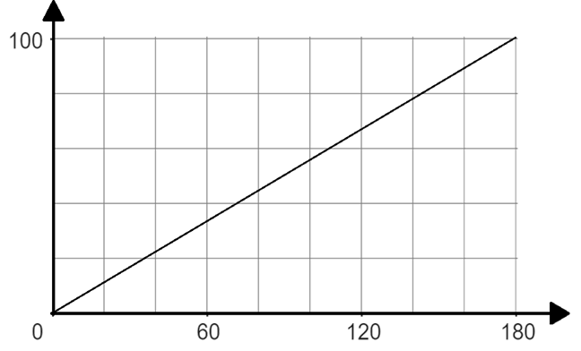
Comparing representations
2a) Fill in the missing information, using the different representations.
0
20
40
60
80
100
Amount | %
 | 100
 | 40
 | 15
%
×1.8
×1.8
180
£
72
0
36
72
108
144
180
27
%
40
100
%
£
72
180
£

Slide 37
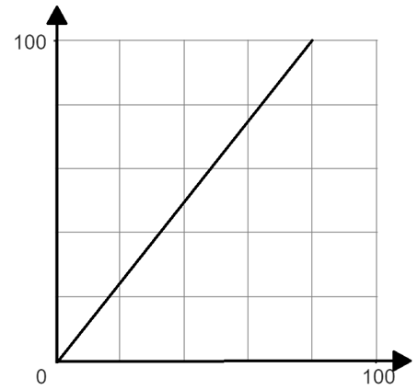
Comparing representations
%
2b) Fill in the missing information, using the different representations.
Amount | %
 | 100
 | 50
32
0.4
80
×0.8
40
40
0.5
£
50
0
20
40
60
80
100
%
%
£
£
× 0.8
40
16
32
48
64
0
80

Slide 38
Scaling diagrams for multiplicative relationships
A multiplicative relationship can be represented a number of ways including double number lines, scaling diagrams and ratio tables.
The scaling diagram shows us how multiplication can be seen as scaling and how the double number line relates to this.

Slide 39

© Oak National Academy 2024.
Produced in partnership with Mathematics in Education and Industry.
Licensed on the Open Government Licence v3.0, except where otherwise stated. See Oak terms and conditions.

